Slide 1

OOP2 Presentation
Online
Medicine
Group Members:
1.Bushra Amana [18-36568-1]
2.Shafin Talukder [18-36588-1]
3.Arshad Hassan Aywon [18-36601-1]

Slide 2
Introduction
Online Medicine:
*Local
*Foreign
#Request Unavailable Medicines
Why this proposal ?
Save time.
Easily order
USER CATEGORY
Customer.
Admin.

Slide 3
Some website for online medicine
SOME WEBSITES FOR ONLINE MEDICINE :
ONLINE PHARMACY INDIA
TRUST PHARMACY
DRUGS.com
NHS PHARMACY UK
SOME WEBSITES FOR ONLINE MEDICINE (BANGLADESH)
E-sastho Seba
Doctorsbd.com
FEELWELL
Square Hospital Limited
Popular hospital Limited
Why you use our system for online medicine purpose?

Slide 4
Working Process
User
1.Login
2.Registration
3.Search Medicine
4.Select Medicine
5.Order Medicine
6.Request Medicine
7.Order & Request Medicine

Slide 5
Working Process
Admin
1.Login
2.Search Medicine
3.Add Medicine
4.Edit Medicine
5.Delete Medicine
6.Remove or Block Users
7.List of ordered & requested Medicine

Slide 6
DIAGRAMS

Slide 7
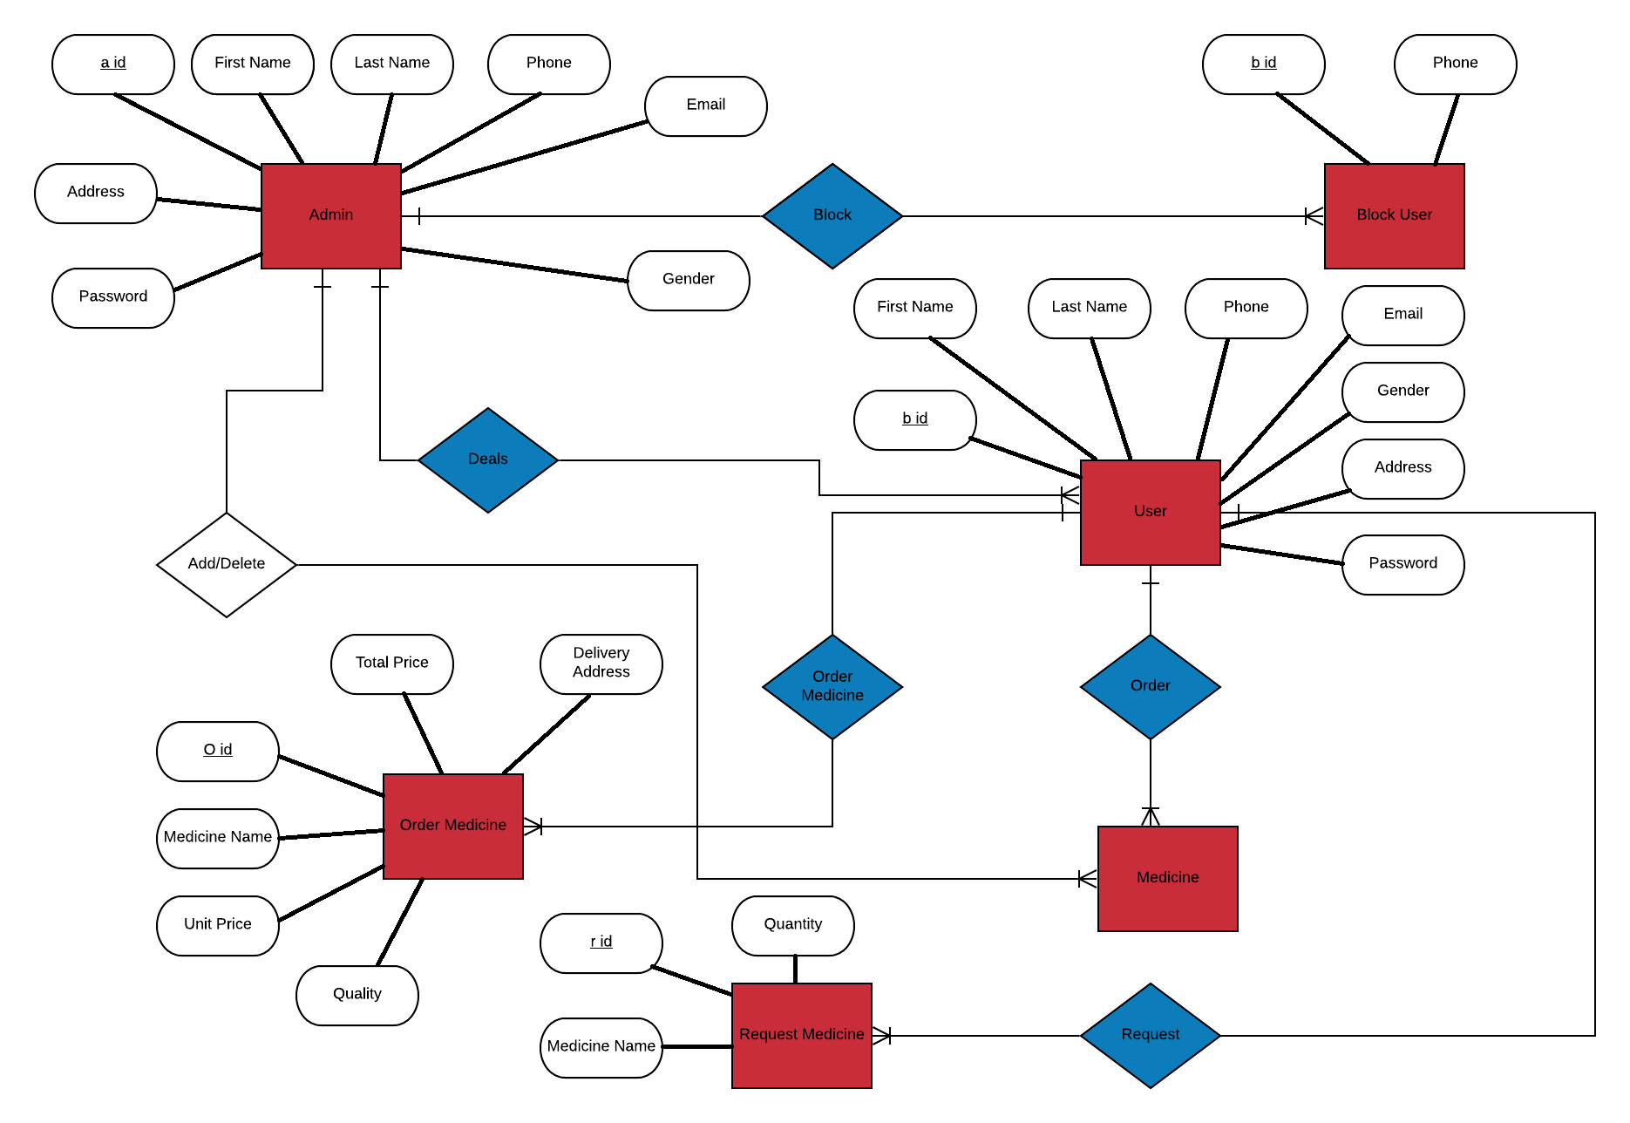
ER Diagram

Slide 8
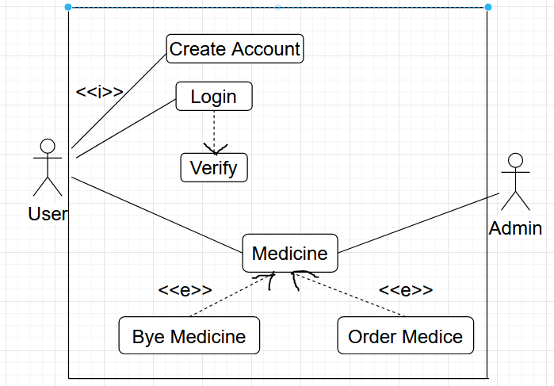
Use Case Diagram

Slide 9
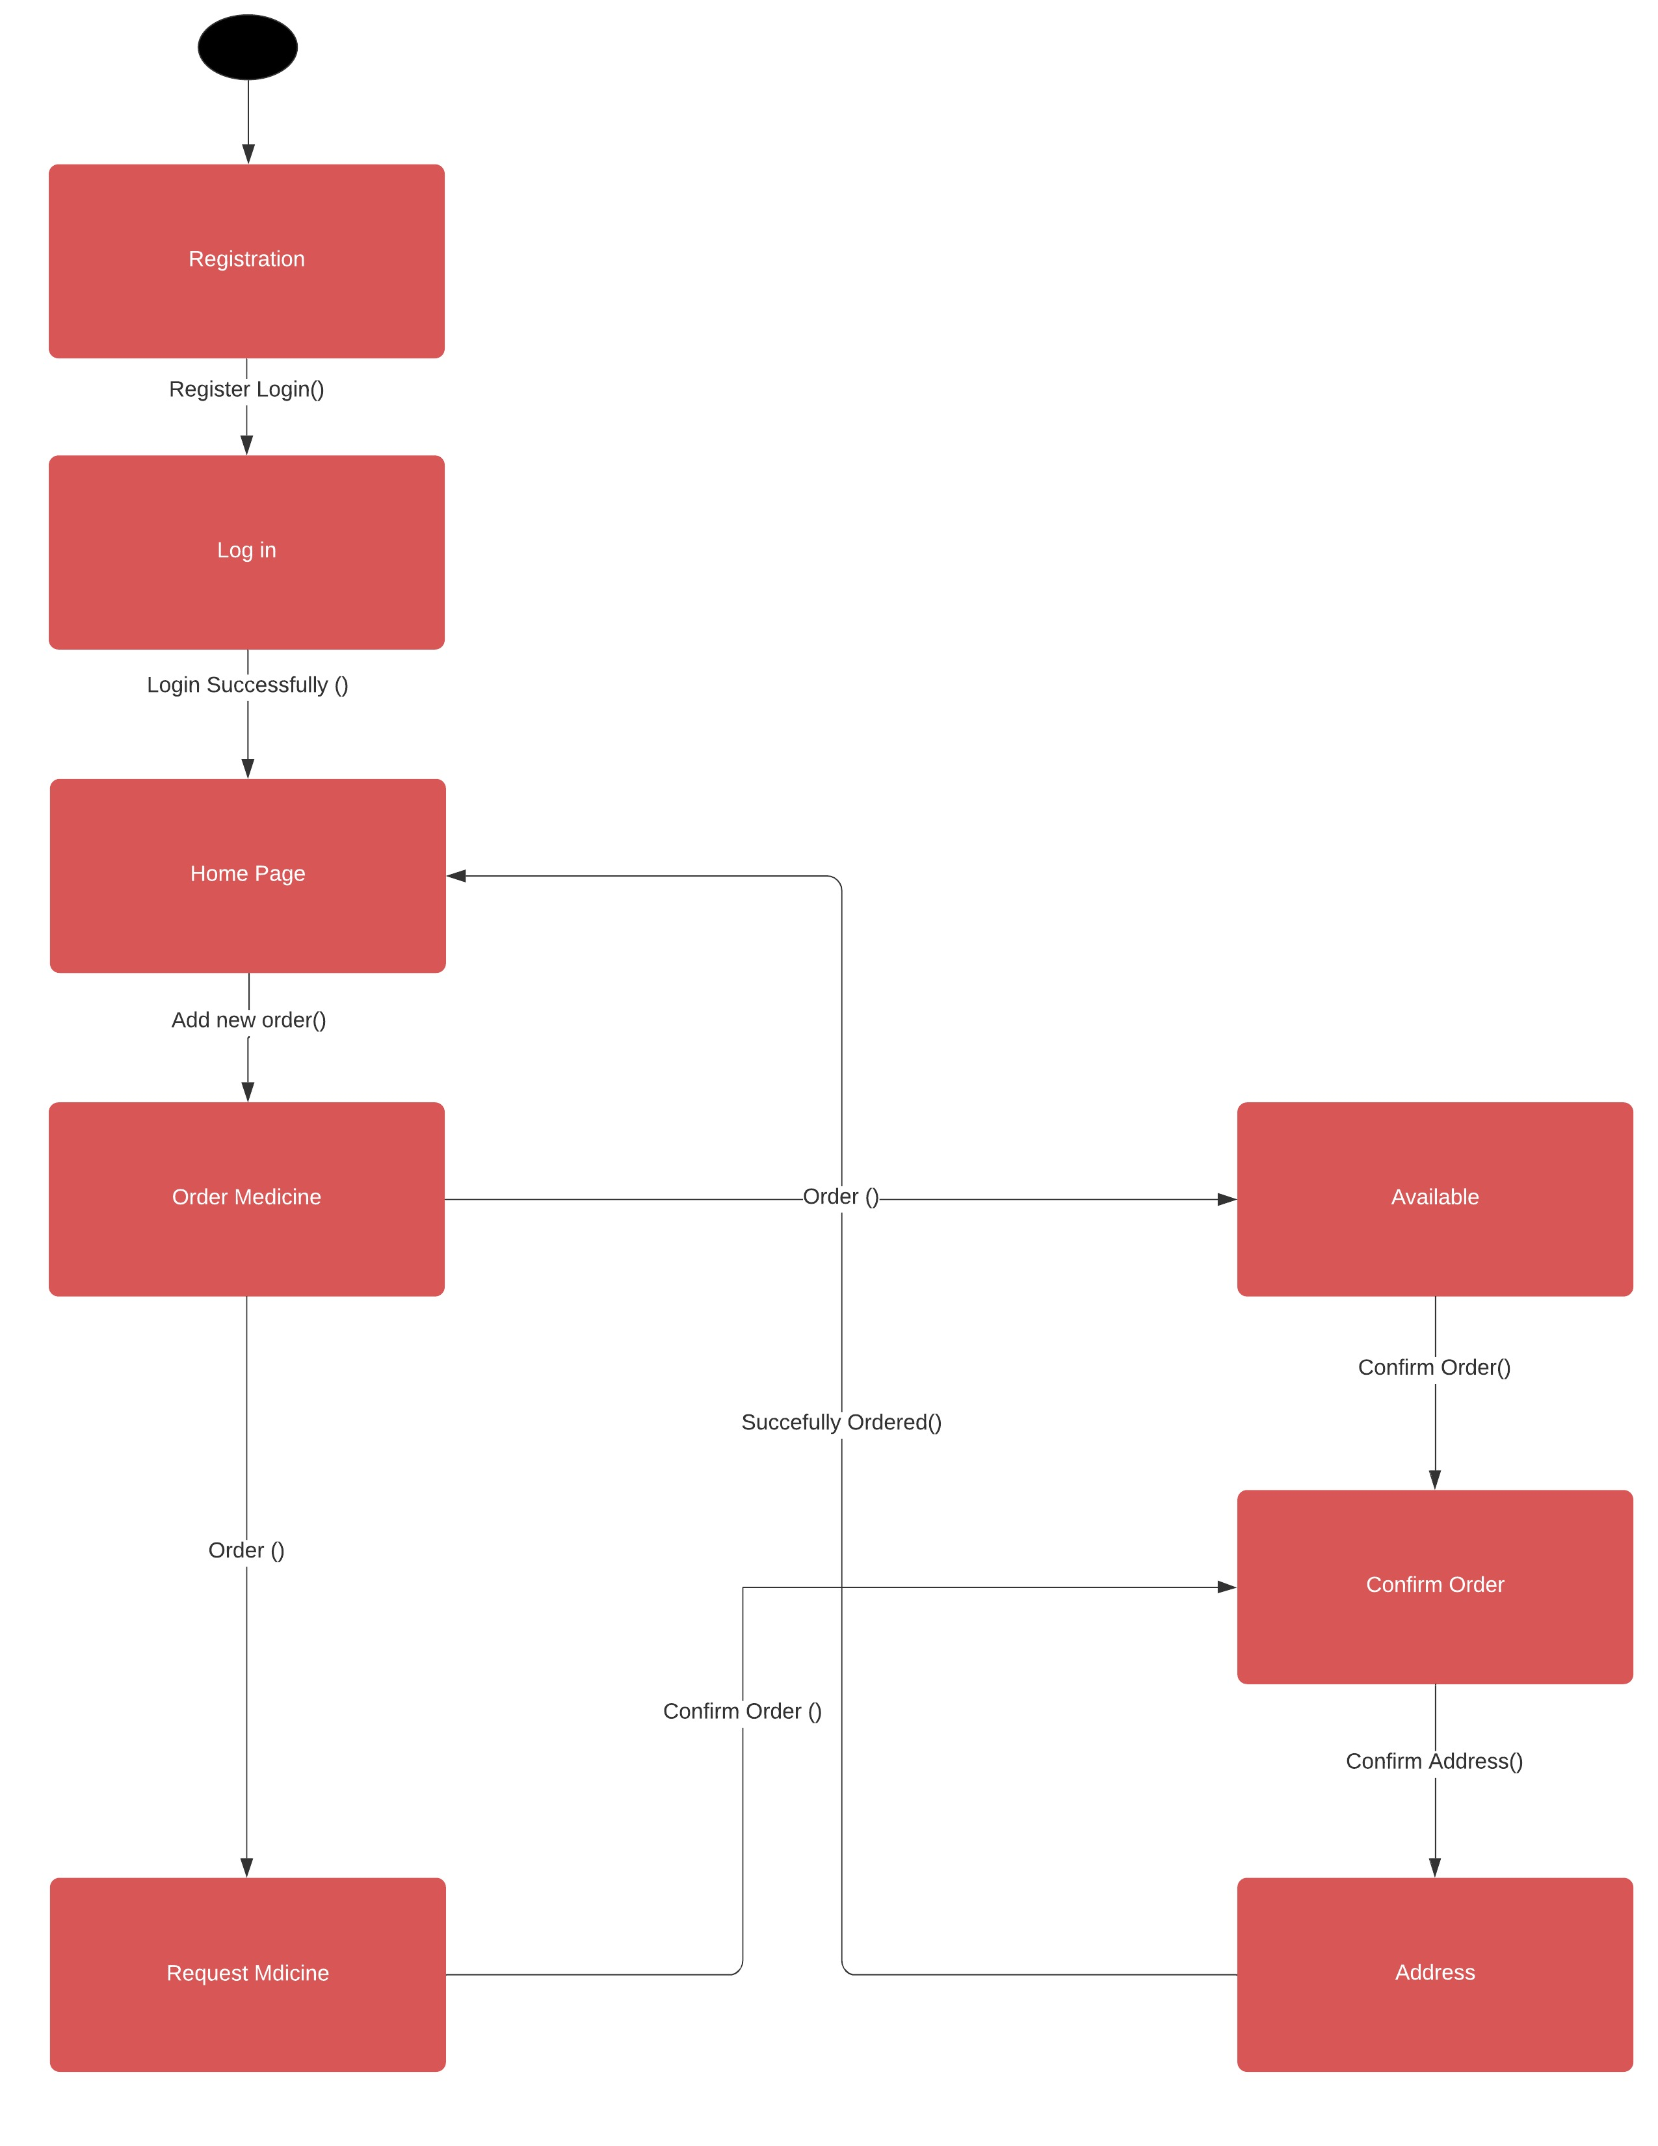
Statechart Diagram

Slide 10
CONCLUSION

Slide 11
Impacts:
Save time.
Save Money.
Save Energy.
Easily order medicine.

Slide 12
Limitations
Accessible for Inner Dhaka.
May take long delivery time.
Not fully user-friendly.
Internet.
Page flexibility.
Individual orders.

Slide 13
Possible Future Improvements
Useable for whole country.
Make fully user-friendly.
Adding more medicines.
Reduce delivery date.
Show suggestions via feedback.
Order multiple medicines at a time.

Slide 14


